Slide 1

From Ulster to Northern Ireland, 1600–1925
Unit 6
Events in Belfast in 1922

Slide 2

January 1922
The first violence of the new year was sparked by the police arrest of 11 members of the Monaghan Gaelic football team in Dromore, county Tyrone, on 14 January. The team included some senior IRA men.
Listen to what happened next.
Why do you think James Craig might have had some doubts about meeting Michael Collins in person?

Slide 3
February 1922
O’ Duffy put his proposal into action and sent IRA units across the border on 7 February. They met more resistance than expected, but still seized 43 unionists and brought them back across the border as hostages to stop the three executions in Derry. The British government had changed the three death sentences to imprisonment some hours earlier, but word had not reached the IRA men before they went into action. The IRA operation generated enormous panic among border unionists, many of whom went into hiding. The unionist hostages and Monaghan footballers were released after pressure from the British government on Craig and Collins.
Listen to what happened next.
Why do you think the loyalist extremists were getting
more desperate, according to Parkinson?

Slide 4
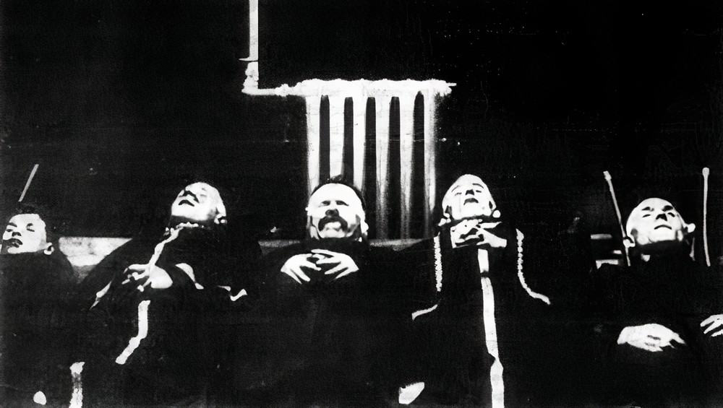
March 1922
In March, sixty-one people were killed in Belfast and there were further expulsions of Catholics from their houses, including in Argyle Street off the Shankill Road, close to the Falls. This is an account by Mrs Bunting, a Catholic mother from Argyle Street, quoted by historian Diarmaid Ferriter:
‘We heard the front door being attacked and then burst open. A leader of the mob, who was well dressed compared to the others, told us to get out, giving us a minute to do so. He called us Sinn Féin b******s and to do as we were told or we would all be blown up. He then joined the mob outside. This occurred about 5 am. There was only one other Catholic woman left in the street, the rest having been previously put out.’
On the night of 23 March, an armed gang invaded the Antrim Road home of a well-known moderate nationalist, a supporter and friend of Joseph Devlin, Owen McMahon. He owned several bars across the city and served as a director of Glentoran football club. He was shot dead, along with four of his sons and an employee.
Listen to what happened next.
The McMahon murdered family

Slide 5
March 1922
One of the groups which organised such revenge killings of Catholics was called the Cromwell Club.
Can you explain the meaning of the Cromwell Club name? If you need a reminder check Unit 1.
Michael Collins, angry at the Northern Ireland government’s failure to stop such attacks, ordered an IRA offensive against the police and Specials in west Ulster and in Belfast, in which ten people were killed. The pattern of revenge murders continued, with loyalist attacks against Catholic civilians. For example, when the IRA shot two off-duty Specials in Trillick, County Tyrone, a loyalist group shot three Catholics in the area.
On 31 March there was a sectarian bomb attack on a Protestant family living in Brown Street, in the largely Catholic Millfield area of Belfast, which killed two-year-old Frank Donnelly, and his twelve-year-old brother Joseph.

Slide 6
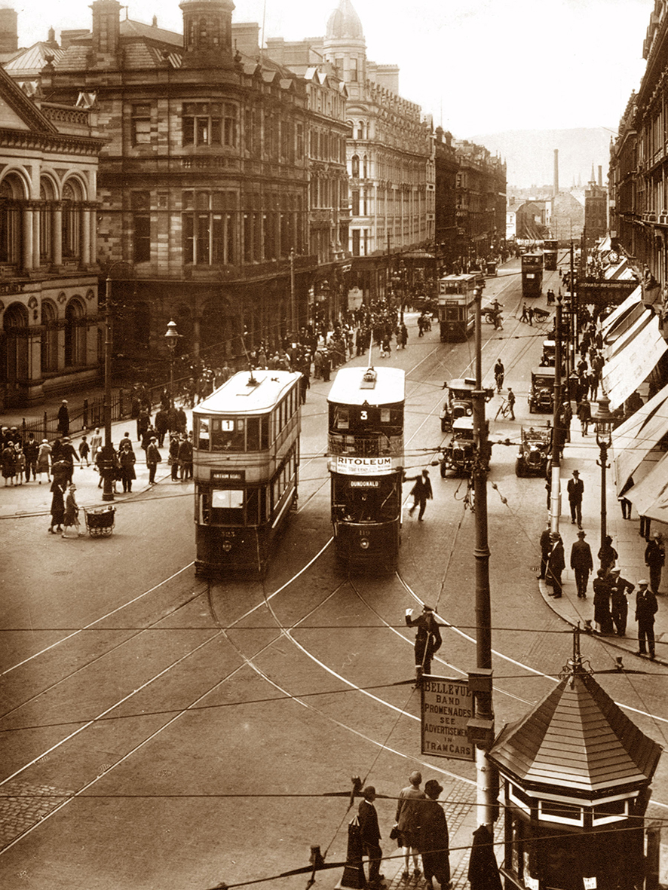
April 1922
On the evening of 1 April an RIC constable, George Turner, was shot dead by an IRA sniper in Belfast. The next night, close to the city centre, Nixon’s murder gang killed six Catholics in what became known as the Arnon Street Massacre.
James Kelly was born on the Falls Road in 1911 and died aged 100 in 2011. His account of an ordinary tram journey in Belfast in 1922 gives a flavour of how dangerous the city was at that time.
Further examples of the hazards of travelling by tram in Belfast during this period are provided by the death of a Protestant tram conductor in a briefcase bomb explosion; the shooting dead of two Catholic men in a sectarian attack on a Crumlin Road tram; the wounding of another Catholic man on a Falls tram; and the death of a Protestant woman after three bombs went off on trams on the same day.
Belfast trams in 1920s in Royal Avenue

Slide 7
April 1922
On 7 April Craig’s government reacted to the rising tide of violence by introducing the Special Powers Act. It allowed the government to use a whole range of extreme measures, including the death penalty, whipping prisoners, and imprisonment without trial, known as internment. A curfew of 11pm was brought in. This meant that anyone caught outside after that time could be arrested.
Dr Marianne Elliott describes how the Act was used ‘more frequently and more severely against Catholics. Between May 1922 and December 1924, the vast majority of the 728 men interned without trial were Catholic, while of the 21 men flogged in prison in 1922 only 3 were Protestants.’ Most internees were held on a prison ship, the Argenta, moored in Belfast Lough.
Watch Additional Resource 2: Martial Law in Ireland. This silent clip shows IRA prisoners in Ballykinler internment camp in county Down in 1921.
What does it tell us about those who were interned in the camp, and the conditions they were kept in?

Slide 8
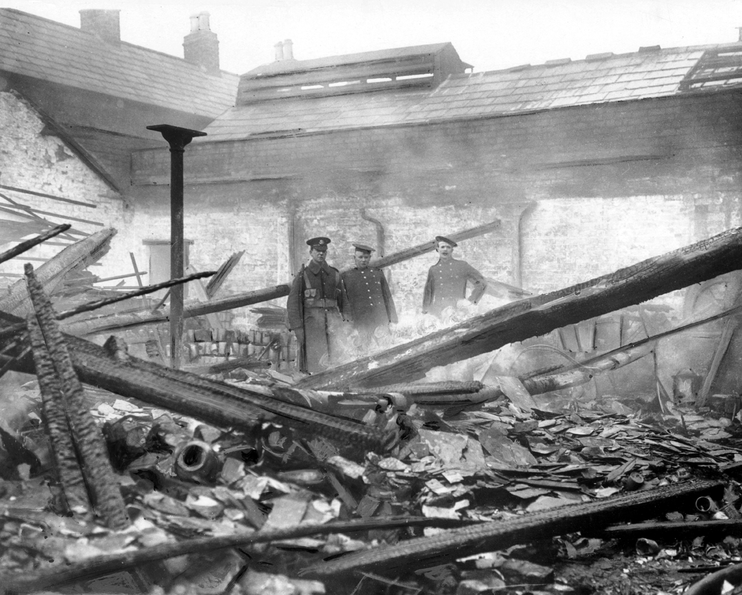
May 1922
Despite the new powers now in place, May was the bloodiest month of the year, with about 80 killings in Belfast, including the killing of Robert Beattie, a Protestant postman, on 13 May and the deaths of two Catholic men and a woman in disturbances after Beattie’s funeral on 16 May.
On 18 May the IRA launched a major new offensive, with a dawn raid on the Belfast RIC HQ in Musgrave Street, killing one constable. Then, on the weekend of 20 May, they started a campaign of burning and destruction in Belfast, Antrim and north Down, aimed at police barracks, large country houses and rural railways. These co-ordinated attacks came as a severe shock to Craig’s government.
Listen to what happened next.
Special and two firemen
in a destroyed building

Slide 9
June 1922
On 1 June the Royal Ulster Constabulary (RUC) officially replaced the Royal Irish Constabulary in Northern Ireland.
Listen to learn more about this and events in Fermanagh.
What event in February had also created panic among border unionists in Fermanagh?
Winston Churchill ordered the British military forces based in Enniskillen to attack the IRA positions. Three Republicans and three British soldiers were killed before the British captured both villages by 8 June. This defeat marked the end of Michael Collins’s Northern Offensive by the IRA. He issued an order for ‘peaceful obstruction… and no troops from the twenty-six counties should be permitted to invade the six-county area’.
Watch Additional Resource 3: The Battle of Belleek.
What do you learn from this about the events in that area?

Slide 10
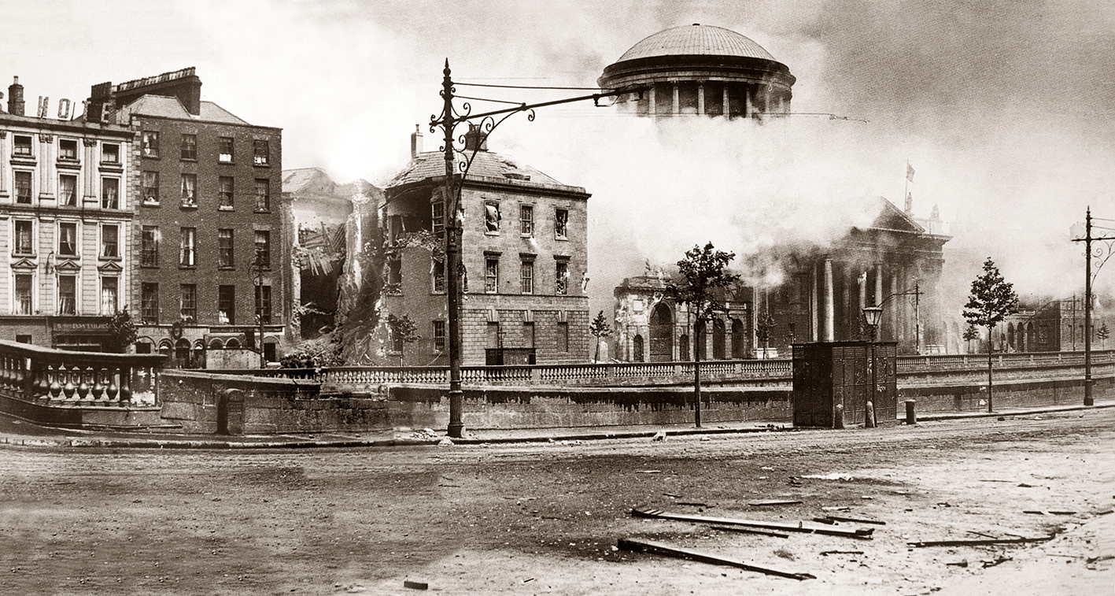
June 1922
At the end of June, the outbreak of open warfare in Dublin between pro-Treaty and anti-Treaty forces in the Irish Civil War eased the pressure on the Northern Ireland government.
Cross-border attacks stopped suddenly, and many northern IRA men moved south to join in the fighting. Collins’s government, engaged in a struggle for control of its own territory, lost much of its interest in the north.
Also, Robert Lynch argues that by June 1922 the Catholic population in Belfast had had enough of IRA actions. These actions always provoked brutal revenge attacks against Catholic civilians, rather than against the IRA members themselves. Even Seamus Woods, the IRA leader, recognised that ‘it was the Catholic minority in Belfast which turned against the IRA and sealed its collapse.’
Four Courts in Dublin burning
Do you think Seamus Woods might have blamed Roger McCorley for this? Why?

Slide 11
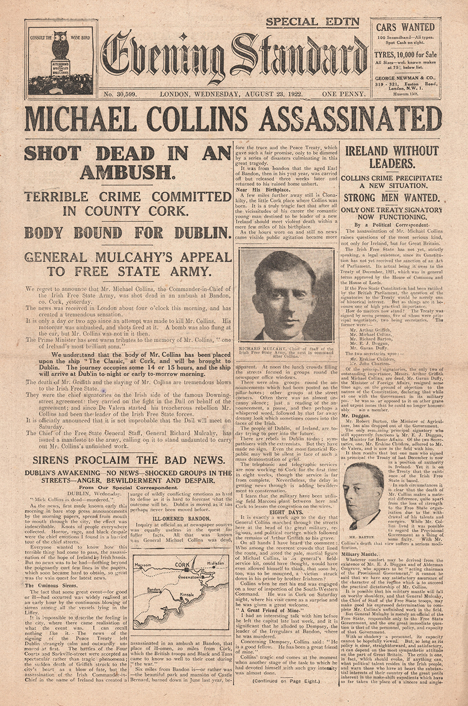
August 1922
Michael Collins’s death in an anti-Treaty IRA ambush in Cork in August meant that the southern leader who had taken the most interest in Ulster Catholics, and who had done the most to try to help end partition, was gone: ‘His death was another stroke of good luck for the Ulster unionists’ (Laffan). The Civil War in the south did not end until nearly a year later, in May 1923, by which time the north had experienced almost a year of comparative peace.
Although Belfast still experienced occasional outrages, the worst of the ‘unholy war’ in the city was over, at least for fifty years or so. There were no sectarian murders in Belfast between 1923 and 1933.
Collins assassinated (Evening Standard)

Slide 12
December 1922
Under the terms of the Anglo-Irish Treaty of 6 December 1921, the Irish Free State was to be established exactly one year later, and Northern Ireland was to have a month (known as the ‘Ulster Month’) to opt out. Sir James Craig, the Prime Minister, travelled to London on 7 December 1922 with the formal opt-out. On 13 December, he announced to the Northern Ireland House of Commons that King George V had approved it. This marked the handing over of many powers from Westminster to the government of Northern Ireland, though the UK government retained overall authority.
Do you think that Sir James Craig and his government could now relax?

Slide 13
Credits
Slide 4 and 5:
The McMahon murdered family
from Slugger O’Toole (unknown copyright)
Slide 6:
Belfast trams in 1920s in Royal Avenue © KGPA Ltd/Alamy Stock Photo
Slide 8:
Special and two firemen in a destroyed building © Belfast Telegraph
Slide 10:
Four Courts in Dublin burning © De Luan/Alamy Stock Photo
Slide 11:
Collins assassinated (Evening Standard) © John Frost Newspapers/Alamy Stock Photo

